Slide 1
End-to-End Machine Learning Project
(AI)

Slide 2
01
Understanding and Framing the Problem
(AI)
Notes:
Identify the Business Problem
The first and most crucial step in any machine learning project is to identify the business problem. This involves deeply understanding the challenges or opportunities the organization faces and how machine learning can provide a solution. It’s essential to have a clear grasp of the business context, industry, and the pain points that need addressing.

Slide 3
What to do next…
01
02
03
04
Define objectives and success criteria
Frame the problem as a Machine Learning task
Select a performance measure
Check the assumptions
Notes:
Define Objectives and Success Criteria
After identifying the business problem, the next critical step is to define clear objectives and success criteria. This step ensures the project has measurable outcomes that align with the organization’s goals. Objectives should be specific, actionable, and quantifiable. For instance, if the goal is to reduce customer churn, a clear objective could be to develop a predictive model that identifies customers likely to churn within the next 3 months. Success criteria outline how you will measure the project’s performance, such as achieving a specific model accuracy, improving key metrics like customer retention, or reducing costs by a set percentage. Well-defined success criteria ensure the model delivers real, measurable value to the business.
Frame the Problem as a Machine Learning Task
Once objectives are set, the next step is to frame the problem as a machine learning task. This involves translating the business problem into a technical problem that machine learning can solve. For example, if the business goal is to detect fraud in financial transactions, the machine learning task might be a classification problem where the model assigns a label (fraudulent or non-fraudulent) to each transaction. It's important to decide whether the problem is best suited for supervised, unsupervised, or reinforcement learning, and whether it's a regression, classification, or clustering task. Framing the problem correctly ensures the solution is aligned with the most appropriate ML approach.
Select a Performance Measure
To evaluate how well the model meets the objectives, you need to select the appropriate performance measure. This choice depends on the type of problem you're solving. For classification problems, common metrics include accuracy, precision, recall, and F1-score. For regression tasks, you might use metrics like Mean Absolute Error (MAE) or Root Mean Squared Error (RMSE). The performance measure should be tied to the business goals; for example, in fraud detection, minimizing false negatives (fraud that goes undetected) might be more important than overall accuracy. Selecting the right metric ensures that the model’s performance is evaluated in a way that aligns with business needs.
Check the Assumptions
Before building the model, it's essential to check the assumptions behind the data and the model. Assumptions could include things like the data being representative of real-world scenarios, features being independent, or the relationships between variables being linear. If these assumptions do not hold, the model may perform poorly. For example, in a linear regression task, assuming linearity between features and the target variable may lead to problems if the actual relationships are nonlinear. Regularly validating assumptions about data quality, distribution, and relationships helps avoid pitfalls in model development and ensures the solution is grounded in real-world conditions.

Slide 4

Example 1
Notes:
Reducing Customer Churn in a Subscription Service
Define Objectives and Success Criteria:
Objective: Build a machine learning model to predict which customers are likely to cancel their subscription within the next 3 months.
Success Criteria: Achieve at least 80% accuracy with a recall of 90% to ensure most at-risk customers are identified. Success is also measured by a 15% reduction in churn over the next 6 months after the model is deployed.
Frame the Problem as a Machine Learning Task:
The problem can be framed as a binary classification task, where the model predicts whether a customer will churn (1) or not churn (0). It uses features such as customer activity, interaction with support, and payment history.
Select a Performance Measure:
Given that the goal is to minimize churn, recall (identifying as many customers at risk as possible) and precision (minimizing false positives) are key metrics. The F1-score, which balances recall and precision, is a good overall performance measure.
Check the Assumptions:
Assumptions might include that customer behavior (e.g., activity level) is correlated with churn, and that the data collected over the past 12 months is representative of future trends. If customer behavior changes rapidly, these assumptions need to be revisited or adjusted.

Slide 5

Example 2
Notes:
Detecting Faults in a Manufacturing Process Using AI
1. Define Objectives and Success Criteria
Objective:
Develop an AI-based system that evaluates the quality of manufactured products, beginning with structured feature-based models and later expanding to computer vision models. The system should classify each product into one of five quality levels (Poor, Fair, Good, Very Good, Excellent) and help identify faulty outputs and their causes. Ultimately, this supports the business objective of reducing downtime, minimizing rework, and improving overall product consistency.
Success Criteria:
Achieve at least 85% classification accuracy across the five quality classes.
Enable a 25% reduction in downtime caused by quality-related issues.
Contribute to a 15% reduction in maintenance and rework costs.
Provide explainable outputs in early phases using structured features to support root-cause analysis of quality issues.
2. Frame the Problem as a Quality Classification Task
We frame this problem as a multiclass classification task, where the model predicts the quality class of each product based on structured input features (and later, visual inputs).
Target Variable: A label representing the product quality level, mapped to 5 classes:
0 = Poor
1 = Fair
2 = Good
3 = Very Good
4 = Excellent
Input Features (Phase 1 - Structured Data):
Tool accuracy metrics
Process temperature, pressure, speed
Task execution times
Sensor alerts or anomalies
Operator-related metrics (if available)
Any relevant KPIs collected during manufacturing
Later, in Phase 2, we will include product images to train a Computer Vision model that complements or replaces structured input.
3. Select Performance Measures
Given the multiclass nature of the task and its operational implications:
Precision (per class):
Crucial to avoid mistakenly classifying high-quality products as low-quality (false negatives) or vice versa (false positives). Helps assess trust in predictions for each class.
Recall (per class):
Ensures the model successfully captures all truly defective or high-quality products. Critical for identifying all poor-quality items before they reach customers.
F1-Score (macro & weighted):
A balanced metric that captures performance across all quality levels. Especially useful in early evaluation where class imbalance might exist.
Confusion Matrix:
Will be used to track class-wise performance, especially where misclassifying "Poor" as "Excellent" (or vice versa) is unacceptable.
4. Check the Assumptions and Data Validity
Assumptions for Structured Data-Based Phase:
Data Quality:
Sensor readings, task logs, and operator inputs must accurately represent production conditions. If incomplete, missing, or noisy, model outputs will be unreliable.
Label Reliability:
The assigned quality levels must be based on consistent inspection criteria. Any ambiguity or inconsistency will reduce model accuracy and trust.
Process Stability:
If production processes change (e.g., new machines, updated procedures), the model must be retrained to reflect new patterns.
Assumptions for Vision-Based Phase (CV):
Image Consistency:
Product images should be captured in consistent lighting, angle, and resolution.
Label-Image Alignment:
The quality label assigned must match the product image used for training. Manual inspection protocols should be followed.

Slide 6
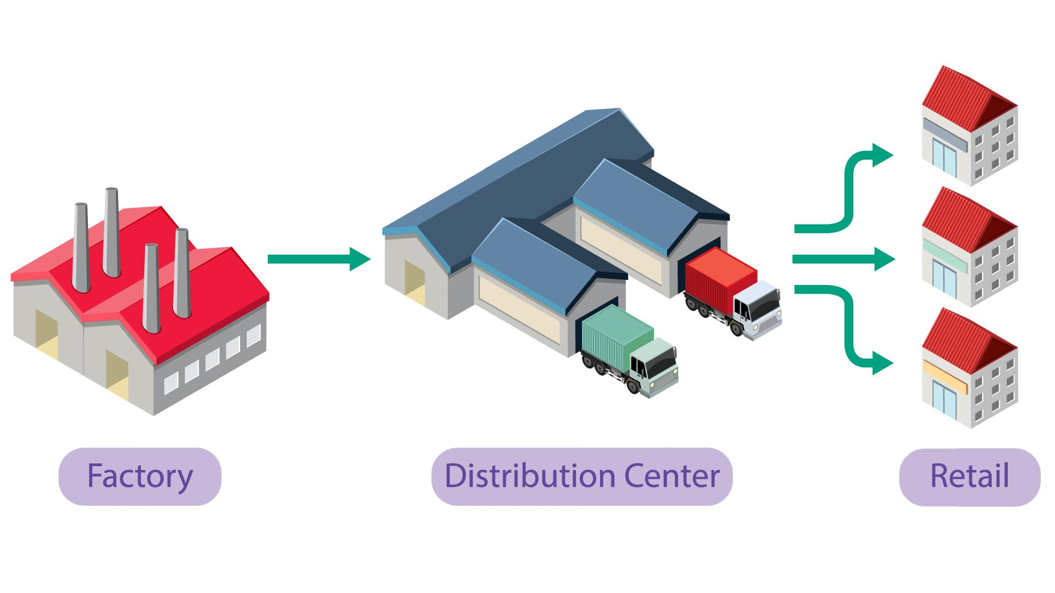
Example 3
Notes:
Optimizing Supply Chain Delivery Routes for a Global Retailer
Define Objectives and Success Criteria:
Objective: Develop a machine learning model to optimize delivery routes across multiple global regions, reducing transportation costs and delivery time while considering factors like traffic, weather, and fuel consumption.
Success Criteria: The model must reduce delivery time by at least 10% and transportation costs by 15% within the first 6 months of implementation. The model should also maintain an on-time delivery rate of 95%, while taking into account varying conditions in different regions (e.g., urban vs. rural, different countries, seasonal patterns).
Frame the Problem as a Machine Learning Task:
This is a complex optimization problem that can be approached as a combination of several tasks:
Regression: Predict travel times based on real-time traffic, weather conditions, and historical route data.
Classification: Predict the likelihood of delays (e.g., traffic jams, road closures) and assign risk levels to routes.
Reinforcement Learning (RL): The model can be framed as an RL task where it learns optimal delivery routes by interacting with dynamic environments, learning from real-time feedback (such as delays and fuel consumption), and continuously improving.
The solution may involve integrating these sub-tasks into an ensemble or hybrid approach to handle the complexity of the supply chain.
Select a Performance Measure:
Multiple performance metrics will be needed:
Mean Absolute Percentage Error (MAPE): To measure the accuracy of travel time predictions.
Cost Efficiency: Reduction in transportation costs is a key business metric.
On-Time Delivery Rate: The percentage of deliveries that arrive on or before the expected delivery time.
Cumulative Reward (for the reinforcement learning task): Measures how well the RL model optimizes the overall delivery route, balancing time, cost, and fuel efficiency.
Check the Assumptions:
Several assumptions must be checked in this complex environment:
Data Representativeness: The historical traffic, weather, and fuel consumption data used to train the model must be representative of the actual conditions in different regions. For instance, traffic patterns may vary significantly between New York City and rural areas in South America, or between summer and winter seasons.
Real-Time Data Accuracy: Real-time data feeds (e.g., traffic reports, weather updates) must be accurate and reliable. Any lag or inaccuracy in real-time data could lead to suboptimal route recommendations.
Scalability: The model must be scalable to handle different regions and adapt to various supply chain complexities (e.g., varying infrastructure quality, differences in fuel prices).
Reinforcement Learning Stability: The RL algorithm must be stable and able to explore enough route combinations without converging too early on suboptimal solutions.

Slide 7
Setting Up the Workspace & Getting the Data
(AI)

Slide 8
Split the data into Training, Validation, and Test sets
(AI)

Slide 9
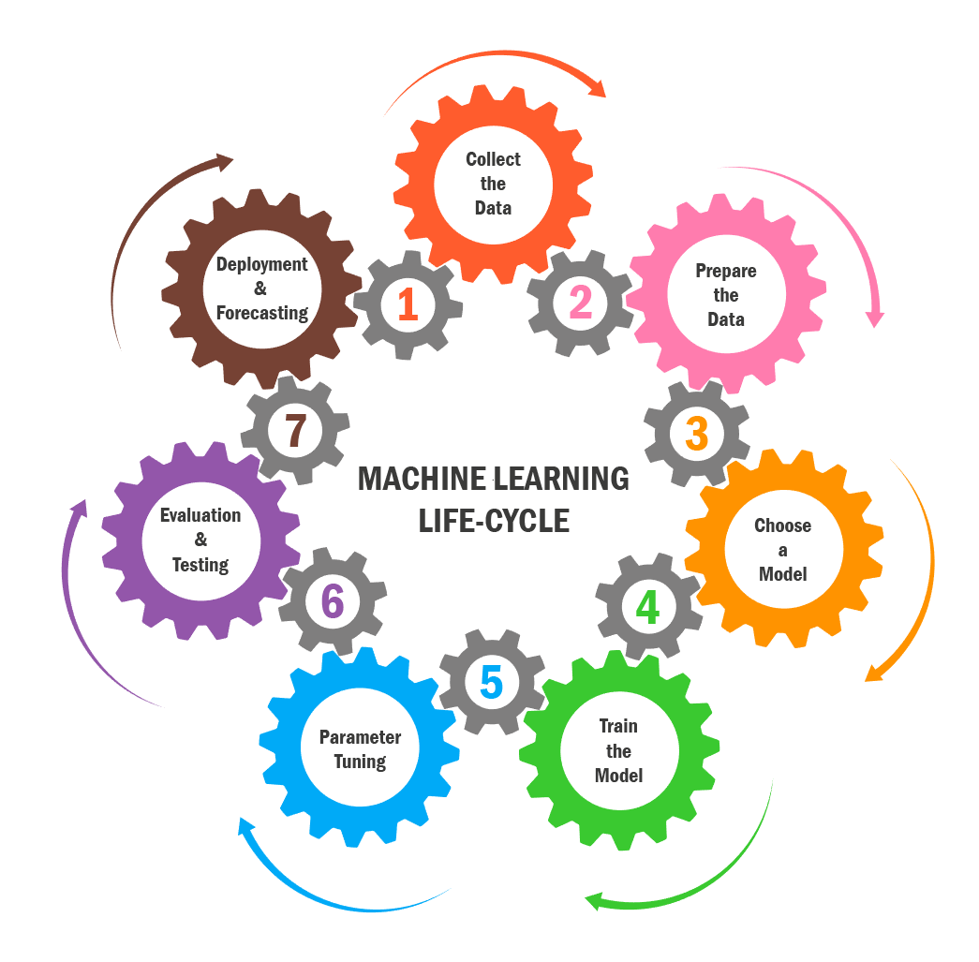

Slide 10
Principles for Robust Model Evaluation in Production
01
02
Prevents Data Leakage
Represents Real-World Scenarios
03
04
Avoids Overfitting to the Test Set
Simulating Real-Time Data Flow

Slide 11

Notes:
What is Data Leakage?
Data leakage occurs when information from outside the training dataset is inadvertently used to train the model, leading to overly optimistic performance during training and evaluation. In simple terms, it happens when the model is able to access information from the future or from the test set during training, which would not be available during actual deployment. This can result in misleading evaluation metrics and poor generalization to new, unseen data.

Slide 12

Notes:
Why do we need train, val, and test?
Represents Real-World Scenarios:
By splitting the data first, you're simulating this real-world scenario, ensuring that your EDA and data cleaning steps are done on data that is representative of what the model will encounter when it's deployed.

Slide 13
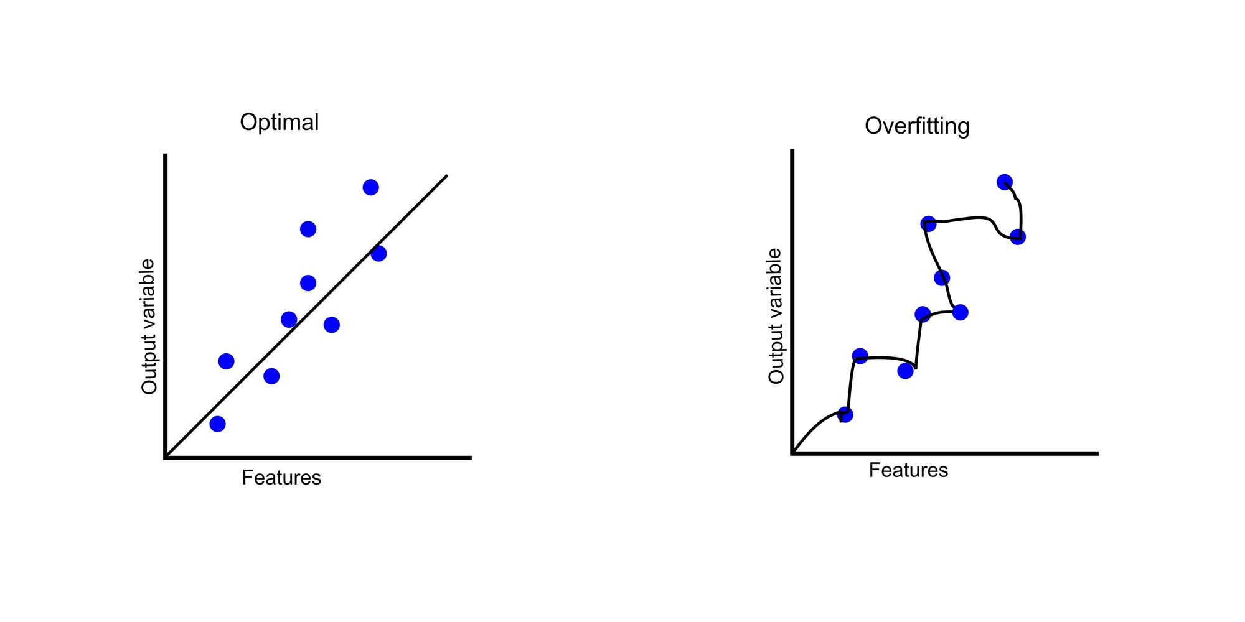
Notes:
Avoids Overfitting to the Test Set:
If you perform EDA and data cleaning on the entire dataset (before splitting), there’s a risk of overfitting your model to patterns that exist in the test data. For example, if you analyze the distribution of features and adjust the transformations based on that, you're indirectly using the test data during the training phase. This can lead to overfitting and a model that performs well on the test set but poorly on new, unseen data.

Slide 14

Notes:
Simulating Real-Time Data Flow:
In real-world machine learning workflows, data cleaning and preprocessing typically occur on the training data first. This mimics the real-time scenario where models are trained on incoming data, and the model is later tested on unseen, future data (represented by your test set).

Slide 15
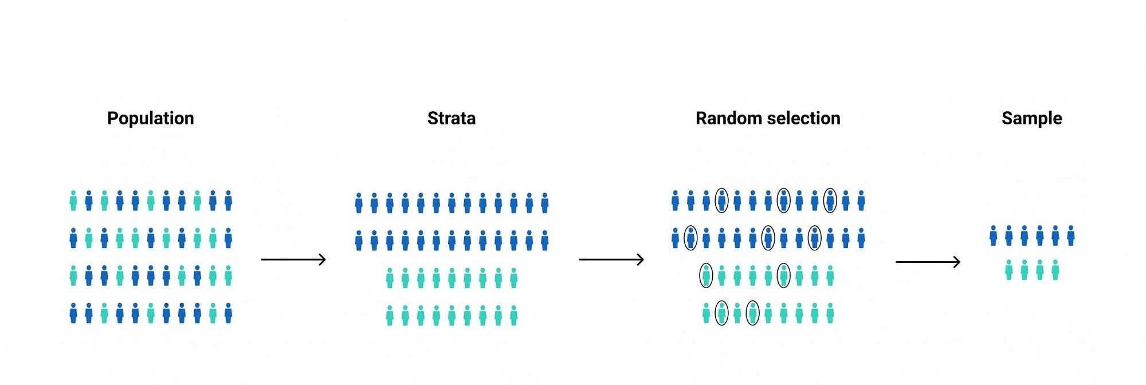
Notes:
Random Sampling: In random sampling, every individual in the population has an equal chance of being selected. The sample is chosen without any consideration of groupings or characteristics within the population. It's a simple, unbiased approach but may not represent the diversity of the population well, especially if certain groups are underrepresented.
Stratified Sampling: In stratified sampling, the population is divided into distinct subgroups (strata) based on specific characteristics (e.g., age, gender, income). A sample is then randomly selected from each stratum, ensuring that each subgroup is proportionally represented in the sample. This method is useful when you want to ensure that key groups are adequately represented in your sample.

Slide 16
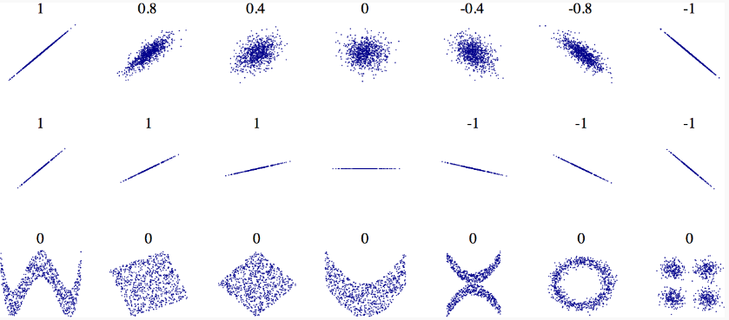
Notes:
Understanding Correlation and Its Limitations:
Correlation measures the strength and direction of a linear relationship between two variables. In the context of a binary classification task, such as predicting survival on the Titanic, Point Biserial Correlation quantifies how strongly a numerical feature is linearly related to the binary target variable.
Key Points:
Correlation Indicates Linear Relationships:
A high positive or negative correlation suggests a strong linear dependency between the feature and the target.
A low correlation value indicates either:
Little or no linear relationship.
A potential non-linear relationship that correlation cannot capture.
Low Correlation Does Not Mean the Feature is Irrelevant:
Even if the correlation coefficient (corr) is small, it doesn't necessarily mean the feature lacks predictive value.
For instance:
A feature may have a non-linear relationship with the target, which correlation cannot detect.
The feature may interact with other features, and its importance might only emerge when combined with them.
Why Not Remove Features with Low Correlation?
Removing a feature based solely on low correlation may lead to information loss:
The feature might capture complex patterns that are not linear.
Some machine learning models (e.g., decision trees, random forests) can capture non-linear relationships effectively, even if correlation is low.
What Correlation Tells Us:
It helps identify linear trends between features and the target.
Features with high absolute correlation values can be strong predictors for linear models.
For features with low correlation, consider exploring their relationships further using visualizations (e.g., scatter plots) or including them in non-linear models.

Slide 17
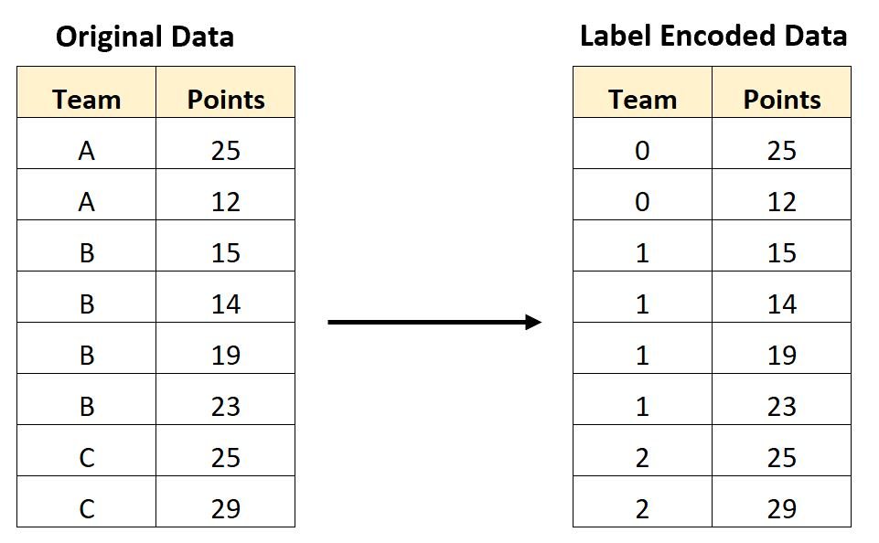
Notes:
Label Encoding: Converts categories to integers (good for ordinal data).

Slide 18
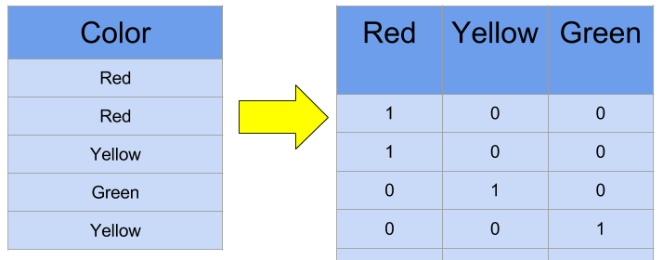
Notes:
One-Hot Encoding: Creates new binary columns for each category (good for nominal data).

Slide 19
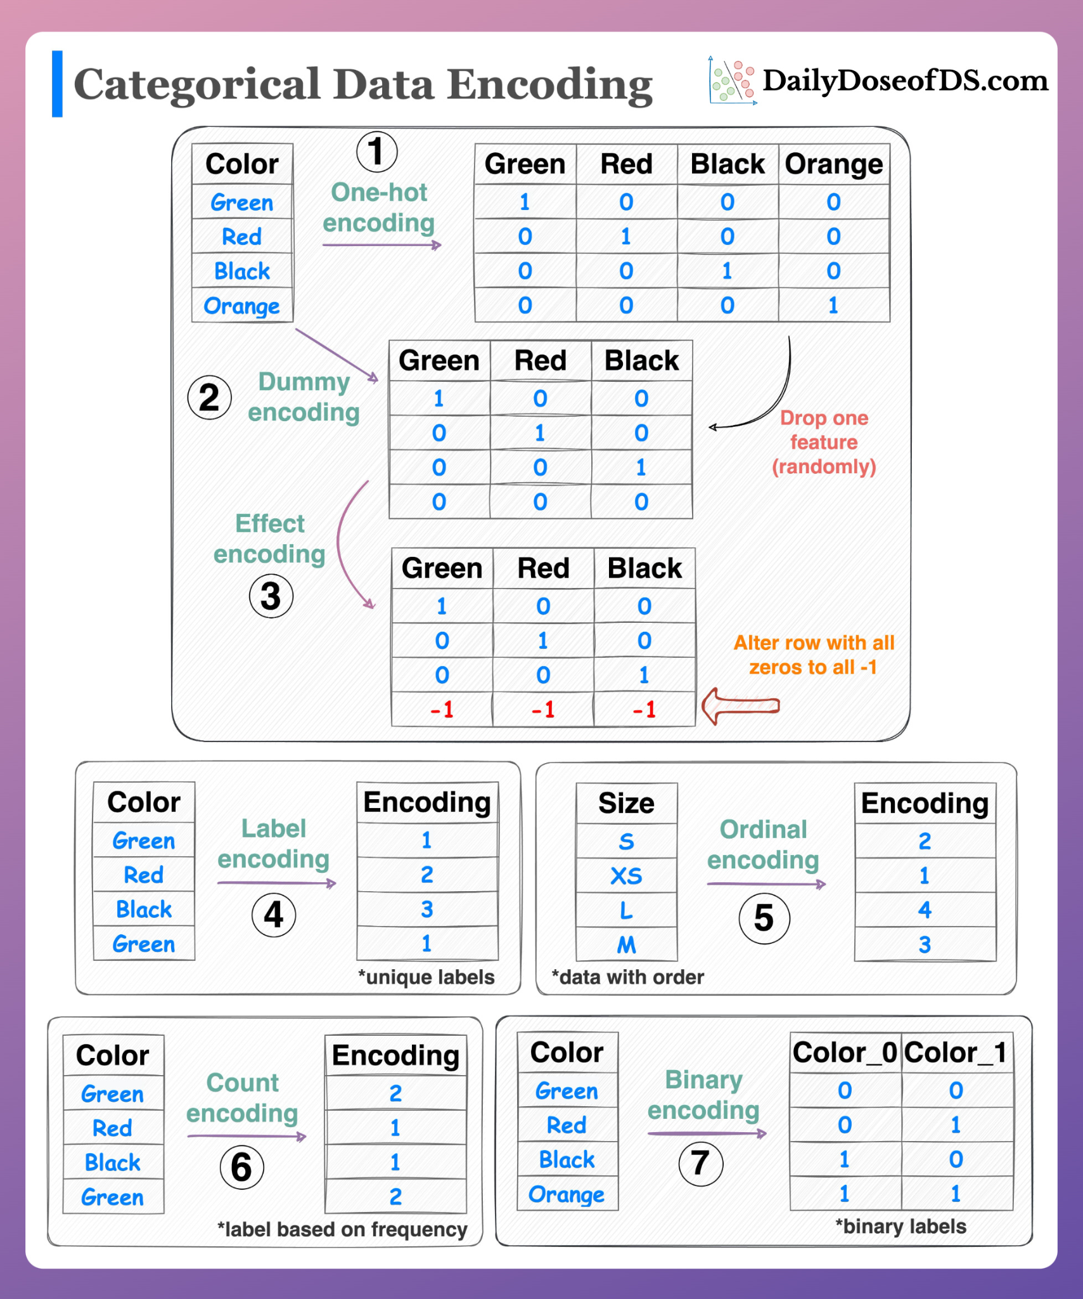

Slide 20
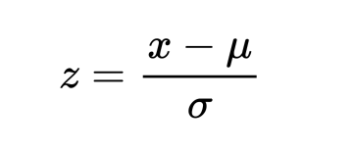
Notes:
StandardScaler:
Purpose: Standardizes the data by removing the mean and scaling to unit variance.
How It Works: It transforms the data such that the resulting distribution has a mean of 0 and a standard deviation of 1.
When to Use:
StandardScaler is useful when the data follows a normal distribution or when you want to treat all features equally regardless of their scale.
It is commonly used when using algorithms like Logistic Regression, Linear Regression, SVMs, and Neural Networks because they are sensitive to the scale of input features.
Effect on Data: The feature values will be scaled to have a mean of 0 and variance of 1. This is especially useful if features have different units (e.g., age in years, income in dollars) to make them comparable.

Slide 21
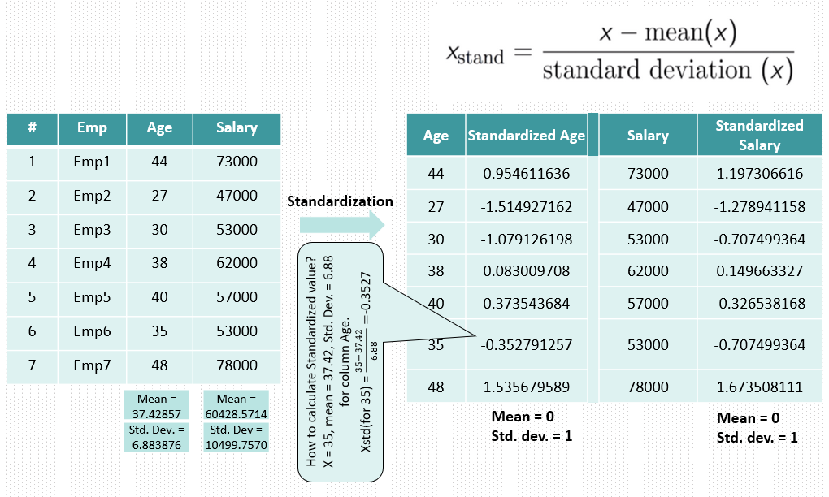

Slide 22
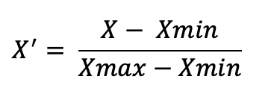
Notes:
MinMaxScaler:
Purpose: Scales the features to a fixed range, typically between 0 and 1.
How It Works: It transforms the data to a given range by subtracting the minimum value of the feature and then dividing by the range (difference between the max and min values of the feature).
When to Use:
MinMaxScaler is often used when you want all features to be in a bounded range (typically [0, 1]) or when you know your model benefits from features having the same range.
It is widely used for algorithms like Neural Networks and K-Means Clustering, which can be sensitive to large values and work better with normalized data.
Effect on Data: All feature values will be scaled to the range [0, 1] (or any other specified range).

Slide 23
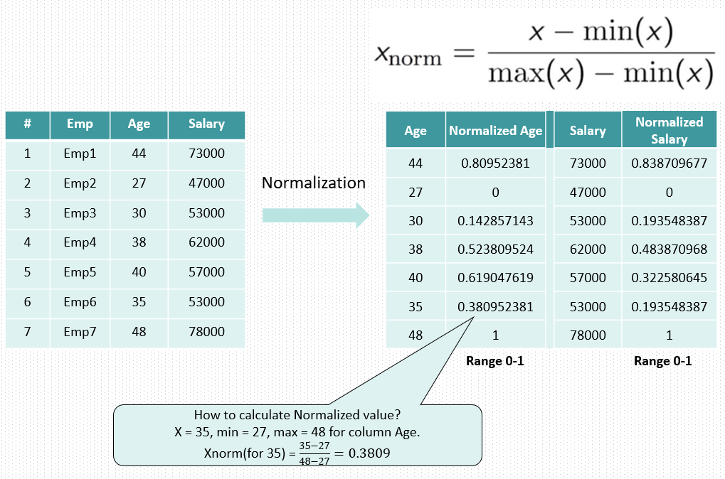

Slide 24
Understanding and Framing the Problem
Setting Up the Workspace and Getting the Data
Split the data into Training, Validation, and Test sets
Exploratory Data Analysis (EDA)
Data Cleaning and Feature Engineering
Final Data Preparation
Model Selection and Training
Fine-Tuning the Model

Slide 25
Questions?

Slide 26
Extra resources
backtesting important for time series .
smote for imbalanced data
ensemble learning
feature selection techniques
dimension reduction
hyperparameter tuning

